Slide 1
Introduction to Computer Graphics
Course Title: Computer Graphics
Course Code: CSE-413
Khandaker Jannatul Ritu, Lecturer(CSE), BAIUST

Slide 2
Books & Resources to follow
Reference Book(s):
1. Computer Graphics Principle and Practice -- James D Foley, Van Dam
2. Computer Graphics Using Open GL – F S Hill J R
3. OpenGL programming Guide-( Official guide to learning opengl )
Reference websites to follow:-
https://www.javatpoint.com/computer-graphics-tutorial
https://www.geeksforgeeks.org/computer-graphics-2/
https://www.tutorialspoint.com/computer_graphics/index.htm
https://www.gatevidyalay.com/computer-graphics/
Recommended YouTube playlists:-
https://www.youtube.com/playlist?list=PLMW5djzR9cKMs2_R1c59401IVQOMOs0pr
https://www.youtube.com/playlist?list=PLncy2sD7w4YpWn8jM9Sk6ISOsCZ7oLn9r
https://www.youtube.com/playlist?list=PLrjkTql3jnm9cY0ijEyr2fPdwnH-0t8EY
https://www.youtube.com/playlist?list=PLYwpaL_SFmcAtxMe7ahYC4ZYjQHun_b-T
Khandaker Jannatul Ritu, Lecturer(CSE), BAIUST

Slide 3
Outlines Of This Lecture
Introduction Of Computer Graphics
Picture, Photo, Image
Cg Vs Ip
Application Of Computer Graphics
Graphics Software
Types Of Computer Graphics:- Interactive And Passive Graphics
Introduction To Graphics Systems
Cathode Ray Tube(crt) Or Refresh CRT
Operations Of Cathode Ray Tube(crt) Or Refresh CRT
Properties Of Cathode Ray Tube(crt) Or Refresh CRT
Pixel Vs Points
Pixel Resolution
Pixel Calculation
Bpp
Img Size
Megapixels
Shades
Maths
Aspect Ratio
What Do You Mean By Aspect Ration 4:3?
Common Aspect Ratio
Advantages Of Aspect Ratio
Aspect Ratio Maths
Pixel Density Maths
Khandaker Jannatul Ritu, Lecturer(CSE), BAIUST

Slide 4
Introduction of Computer Graphics
Graphics are defined as any sketch or a drawing or a special network that pictorially represents some meaningful information. Computer Graphics is used where a set of images needs to be manipulated or the creation of the image in the form of pixels and is drawn on the computer.
To plot some points on a computer screen to make an image
Computer graphics involves technology to accept, process, transform and present information in a visual form that also concerns with producing images using a computer
The study of creating, manipulating, and using visual images in the computer
An art of drawing pictures, lines, charts etc. on computer screen by using programming is known as computer graphics. The activities involved in computer graphics are computations, creation and manipulation of data. The images are generated and manipulated by a rendering tool known as computer graphics.
In computer graphics objects are presented as a collection of discrete pixel elements.
Khandaker Jannatul Ritu, Lecturer(CSE), BAIUST

Slide 5
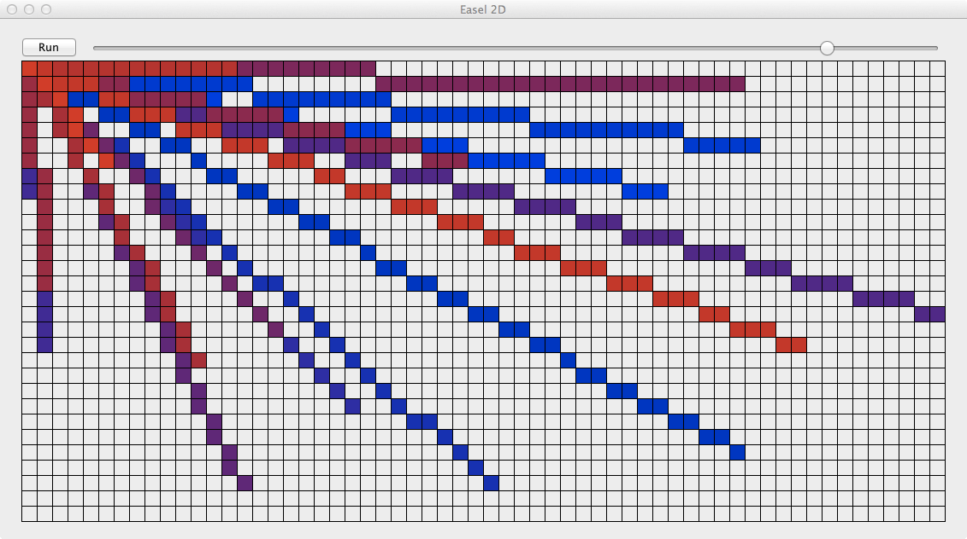
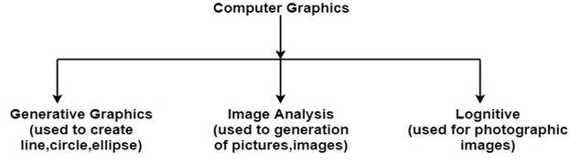
Computer Graphics refers to several things:
The manipulation and the representation of the image or the data in a graphical manner.
Various technology is required for the creation and manipulation.
Digital synthesis and its manipulation.
What is a Picture?
Picture — A drawing, painting, or artwork created on a computer.
What is a Photo?
Photo or photograph — Anything taken by a camera, digital camera, or photocopier.
What is an Image?
Image — Any visual object modified or altered by a computer or an imaginary object created using a computer. A picture that is store in some electronic form. Eg any picture file in your computer.
Khandaker Jannatul Ritu, Lecturer(CSE), BAIUST

Slide 6
Computer graphics vs Image Processing
1. CG: generation of picture using computer
IP: technique to modify or interpret existing pictures
2. CG: synthesizes pictures from mathematical or geometrical models
IP: analyze pictures to derive description of objects appeared in the picture
3. CG: creation, storage, manipulation of images of objects
IP: handles image manipulation or interaction.

Slide 7
Application of Computer Graphics
Computer graphics user interfaces GUIs
− A graphic, mouse-oriented paradigm which allows the user to interact with a computer.
Business presentation graphics − "A picture is worth a thousand words".
Cartography − Drawing maps.
Weather Maps − Real-time mapping, symbolic representations.
Satellite Imaging − Geodesic images.
Photo Enhancement − Sharpening blurred photos.
Medical imaging − MRIs, CAT scans, etc. - Non-invasive internal examination.
Engineering drawings − mechanical, electrical, civil, etc. - Replacing the blueprints of the past.
Educational Software: Computer Graphics is used in the development of educational software for making computer-aided instruction.
Entertainment − Movies and games.
Printing Technology: Computer Graphics is used for printing technology and textile design.
Visualization: It is used for visualization of scientists, engineers, medical personnel, business analysts for the study of a large amount of information.
Typography − The use of character images in publishing - replacing the hard type of the past.
Architecture − Construction plans, exterior sketches - replacing the blueprints and hand drawings of the past.
Art − Computers provide a new medium for artists.
Training − Flight simulators, computer aided instruction, etc.
Simulation and modeling − Replacing physical modeling and enactments
Khandaker Jannatul Ritu, Lecturer(CSE), BAIUST

Slide 8
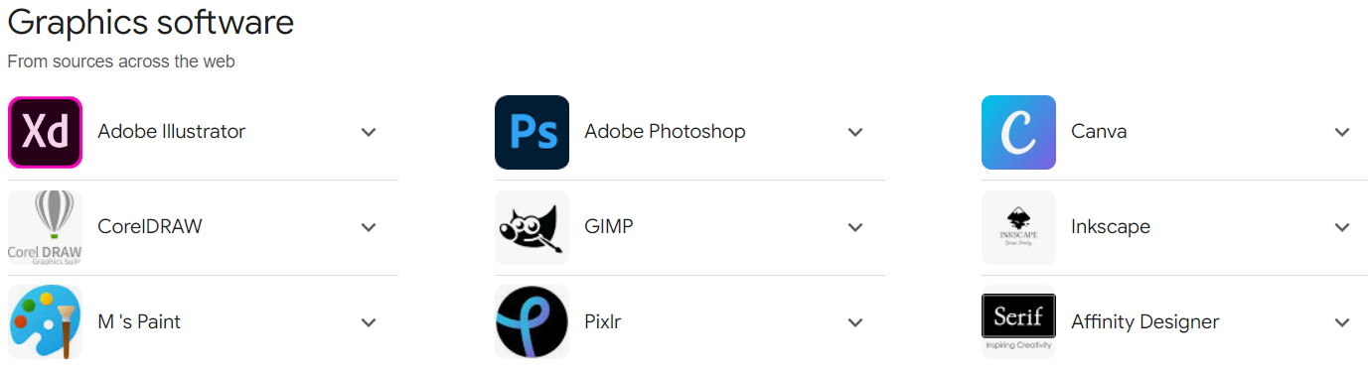
Khandaker Jannatul Ritu, Lecturer(CSE), BAIUST

Slide 9
types of graphics: Interactive and Passive Graphics
Computer Graphics can mainly be divided into Interactive (active) and non-Interactive (passive) parts.
(a) Passive(Non-Interactive) Computer Graphics:
In non-interactive computer graphics, the picture is produced on the monitor, and the user does not have any controlled over the image, i.e., the user cannot make any change in the rendered image. One example of its Titles shown on T.V.
Non-interactive Graphics involves only one-way communication between the computer and the user, User can see the produced image, and he cannot make any change in the image.
(b) Interactive Computer Graphics:
In interactive Computer Graphics user have some controls over the picture, i.e., the user can make any change in the produced image. One example of it is the ping-pong game.
Interactive Computer Graphics require two-way communication between the computer and the user. A User can see the image and make any change by sending his command with an input device.
Khandaker Jannatul Ritu, Lecturer(CSE), BAIUST

Slide 10
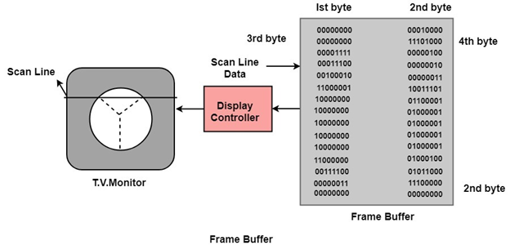
Working of Interactive Computer Graphics:
The modern graphics display is very simple in construction. It consists of three components:
Frame Buffer or Digital Memory: A digital frame buffer is large, contiguous piece of computer memory used to hold or map the image displayed on the screen.
A Monitor likes a home T.V. set without the tuning and receiving electronics.
Display Controller or Video Controller: It passes the contents of the frame buffer to the monitor.
Khandaker Jannatul Ritu, Lecturer(CSE), BAIUST

Slide 11
Introduction to Graphics Systems
With the massive development in the field of computer graphics a broad range of graphics hardware and software systems is available. Graphics capabilities for both two dimensional and three-dimensional applications are general-purpose computers, including many hand-held calculators. On personal computers there is usage of a variety of interactive input devices and graphics software packages; whereas, for higher-quality applications some systems special-purpose graphics hardware and technologies are employed.
Video Display Devices
The primary output device in a graphics system is a video monitor. The operation of most video monitors is based on the standard cathode-ray-tube (CRT) design, but several other technologies exist and solid-state monitors may eventually predominate.
Khandaker Jannatul Ritu, Lecturer(CSE), BAIUST

Slide 12
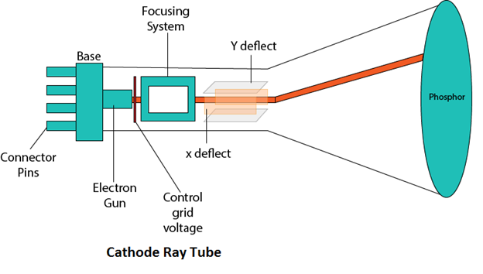
Cathode ray tube(CRT) or refresh CRT
Definition:- Cathode ray tube(CRT) is vacuum tube containing an electron gun and a fluorescent screen to accelerate and deflect the electron beam, used to create images in the form of light emitted from florescent screen.
The image may represent electrical waveforms(oscilloscope), pictures(tv, monitor), radar targets and others.
Components of CRT/ operations of CRT:-
Electron gun
Control grid
Heating filament
Focusing system
accelerating anodes
Deflection system
Phosphor coated screen
Khandaker Jannatul Ritu, Lecturer(CSE), BAIUST

Slide 13
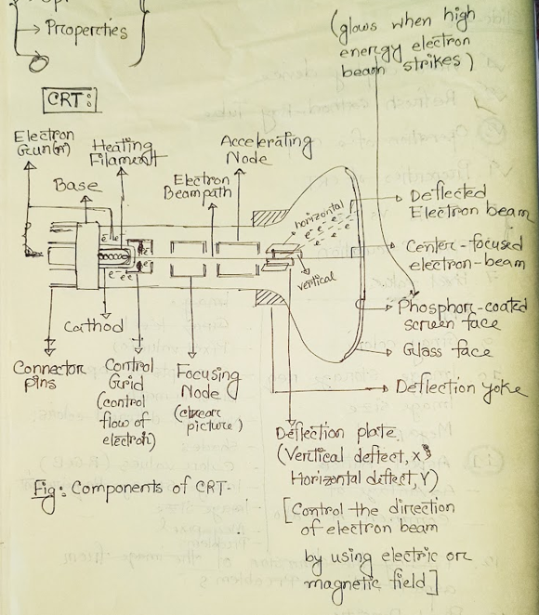
Khandaker Jannatul Ritu, Lecturer(CSE), BAIUST

Slide 14
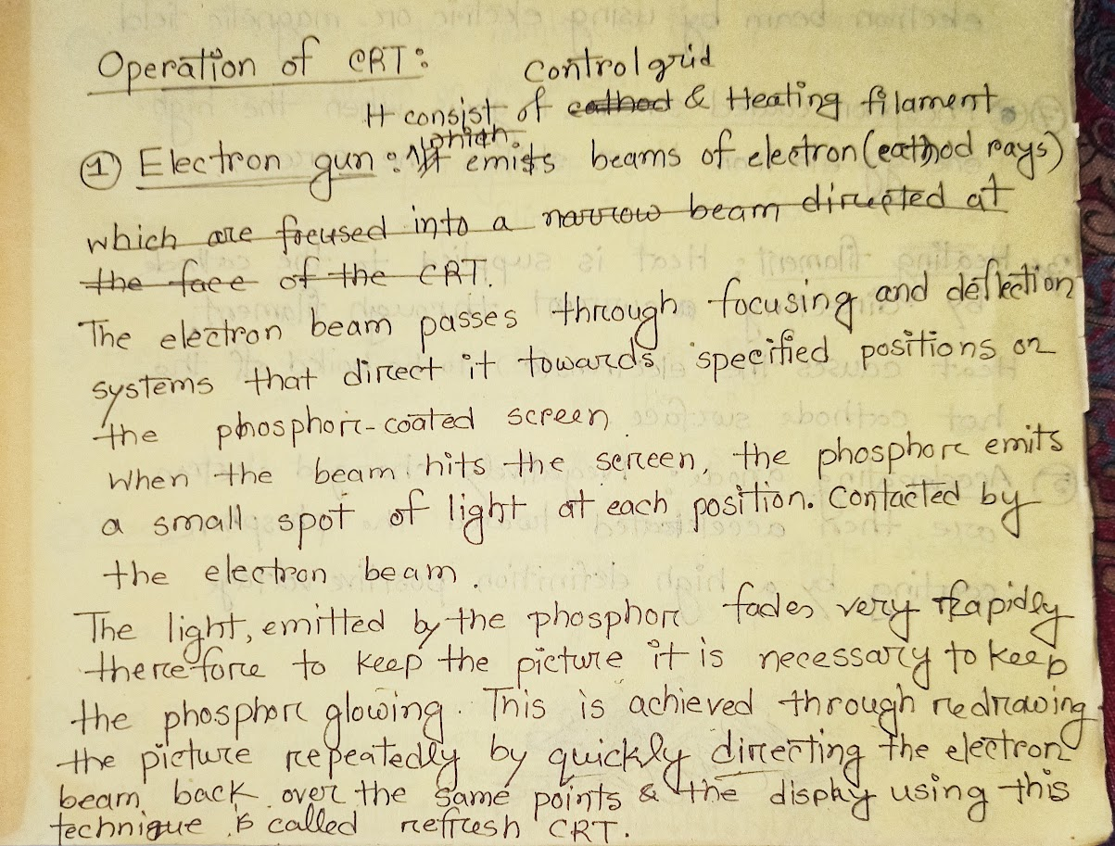
Khandaker Jannatul Ritu, Lecturer(CSE), BAIUST

Slide 15
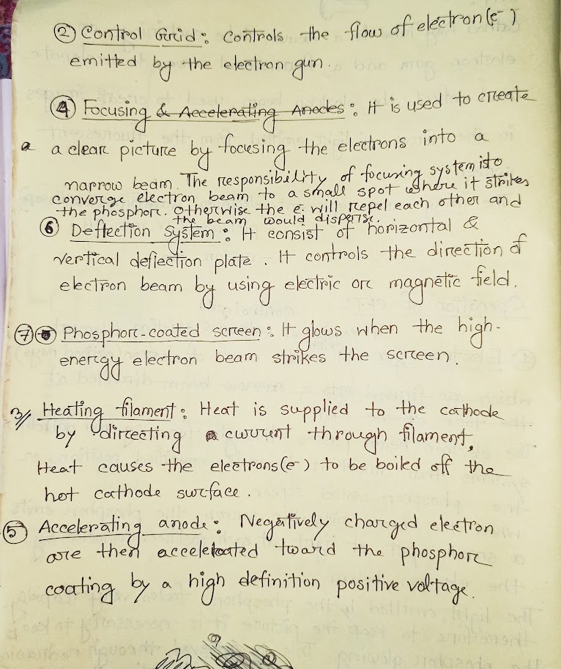
Khandaker Jannatul Ritu, Lecturer(CSE), BAIUST

Slide 16
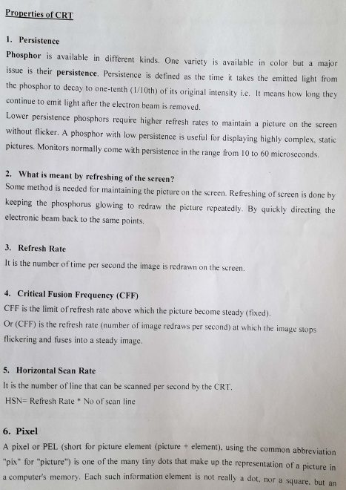
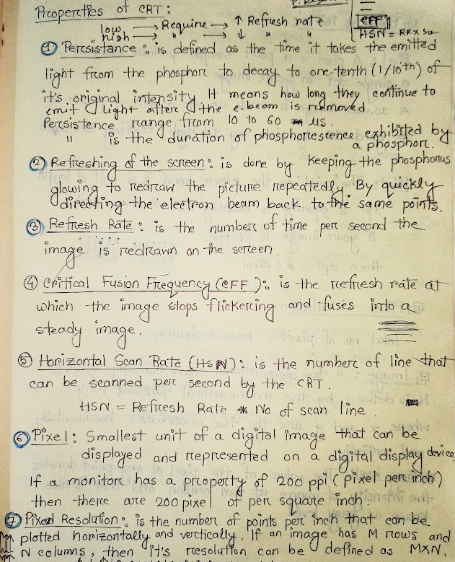
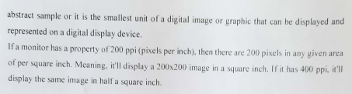

Slide 17
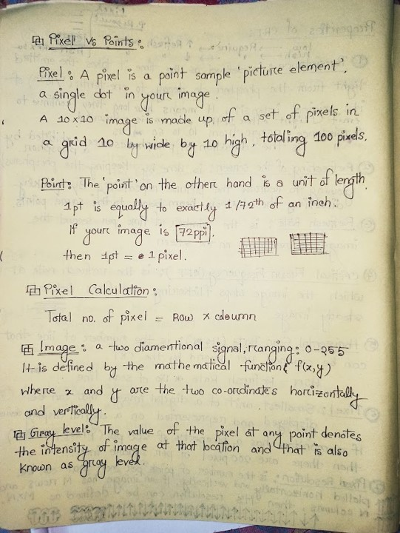
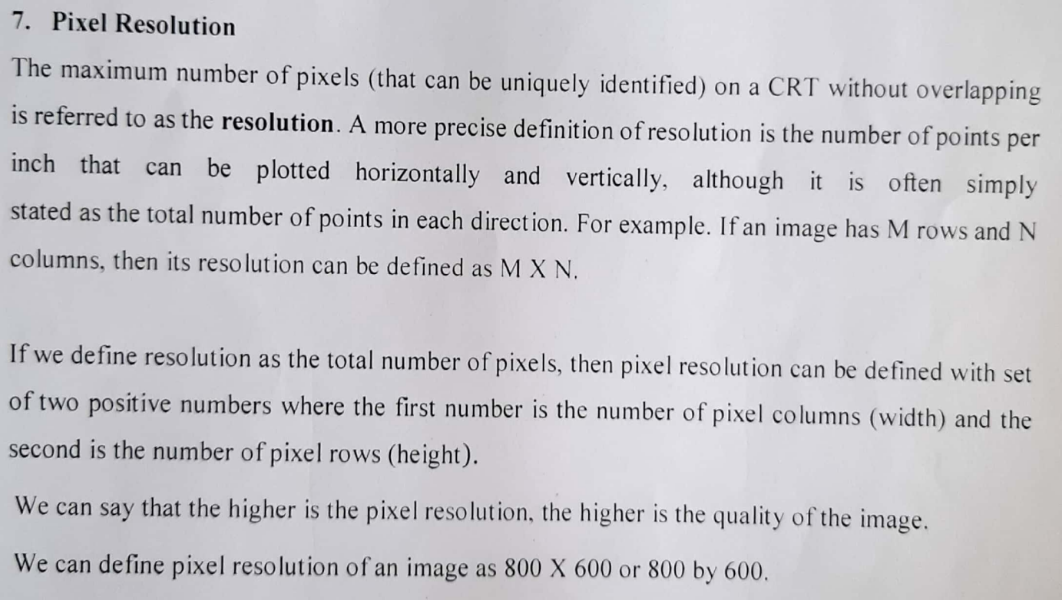

Slide 18
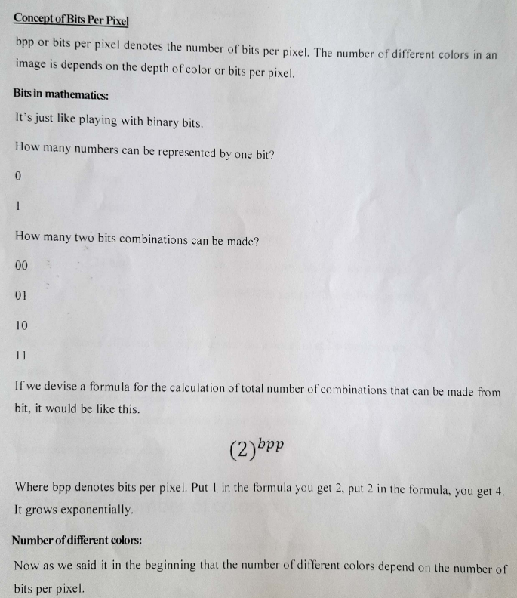

Slide 19
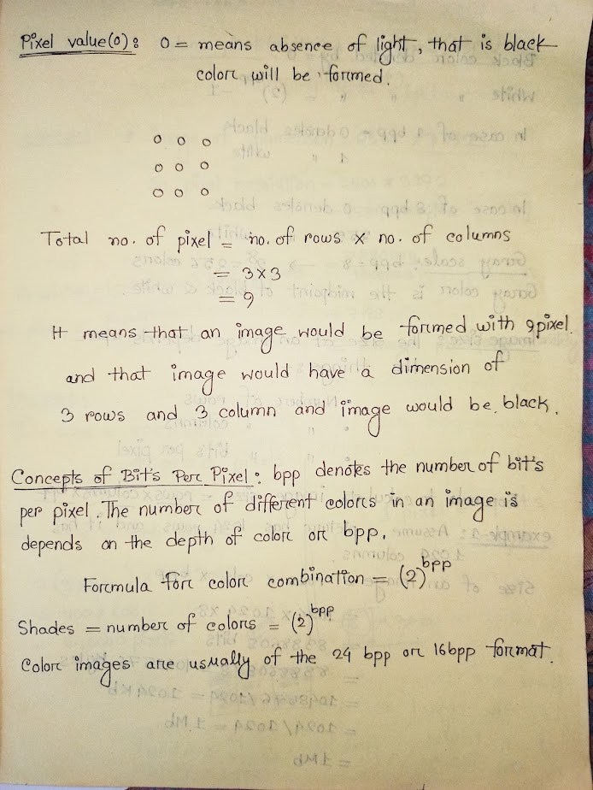
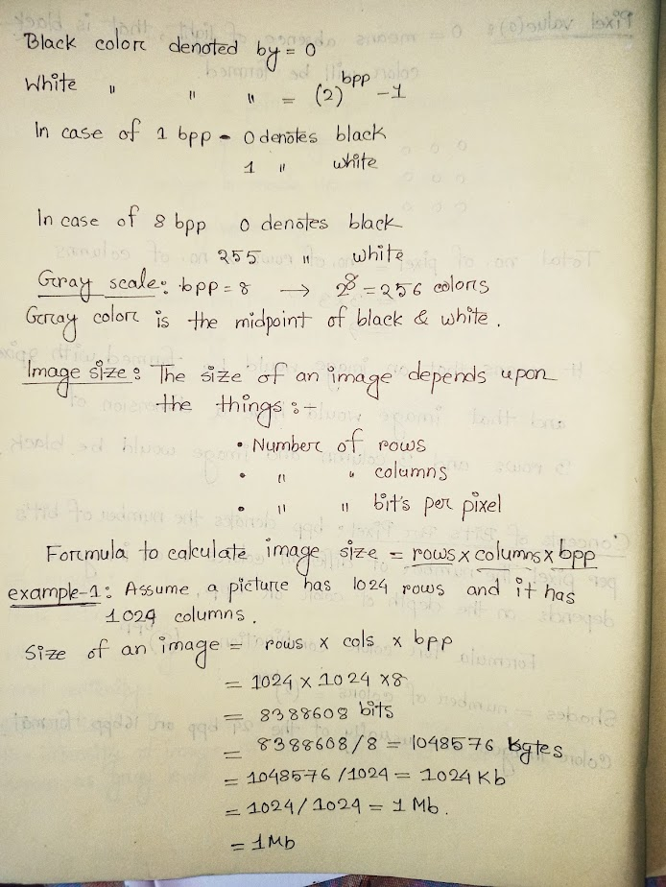

Slide 20
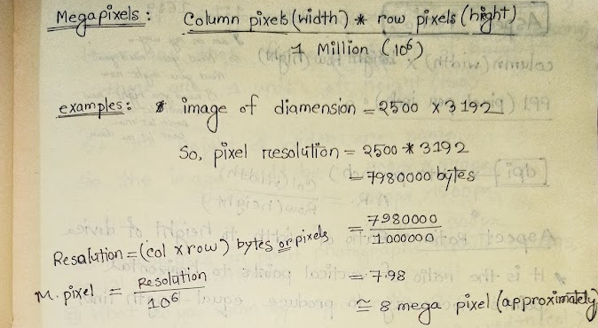
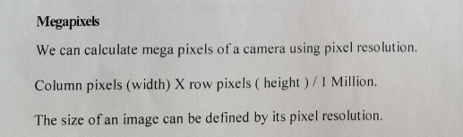
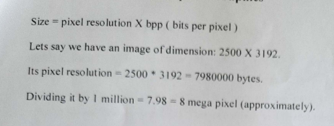
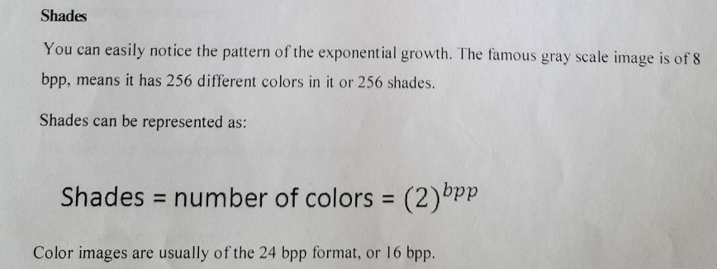

Slide 21
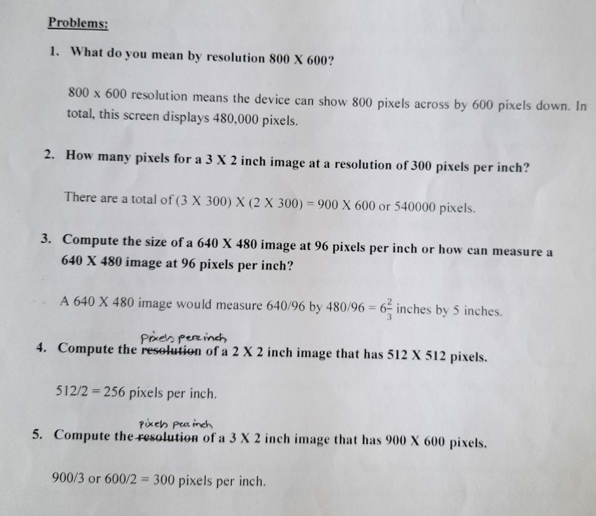

Slide 22
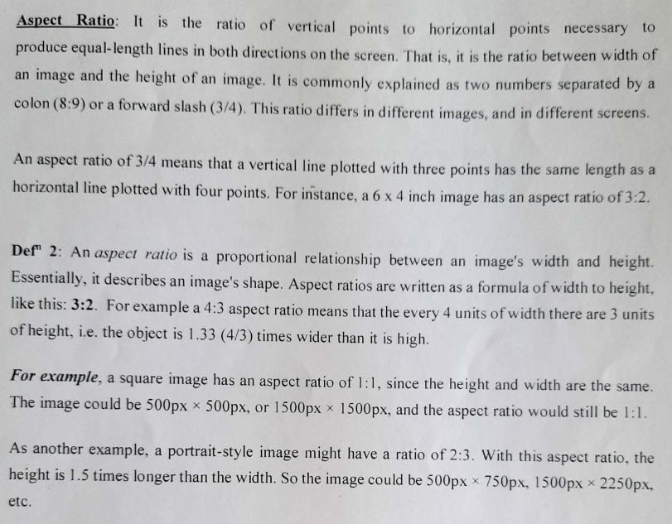
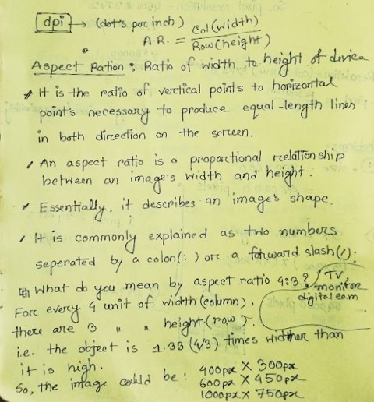

Slide 23
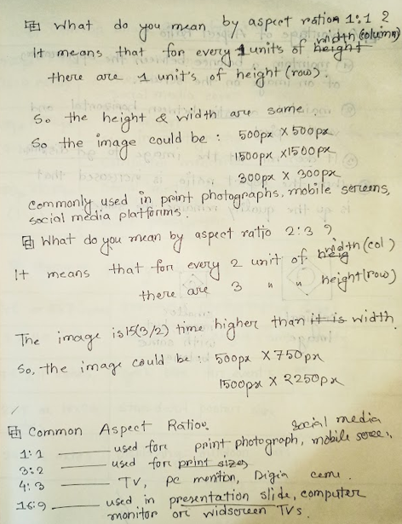
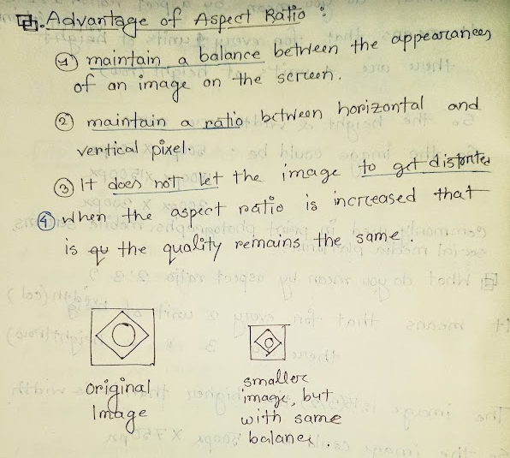

Slide 24
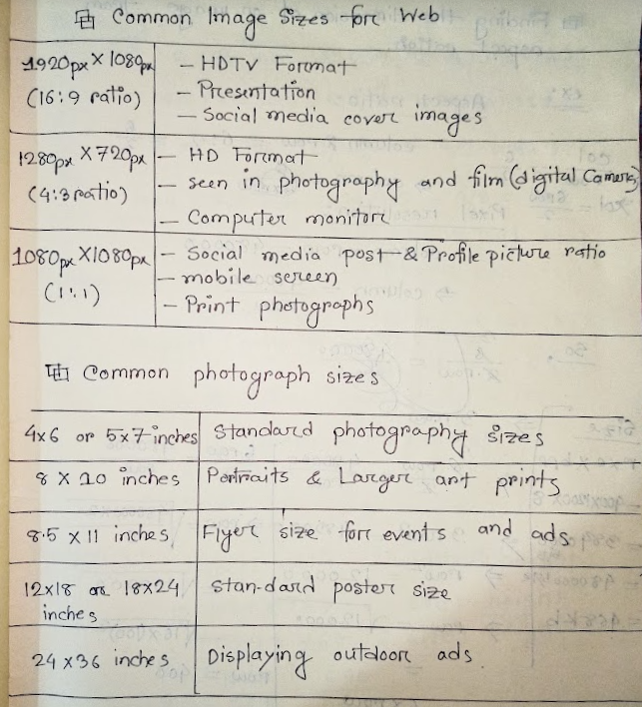
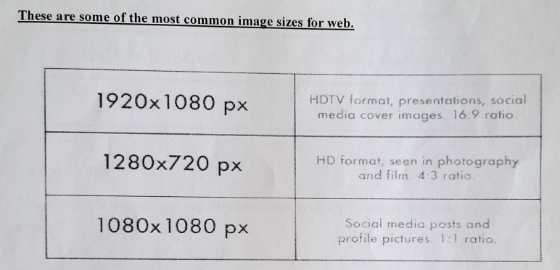
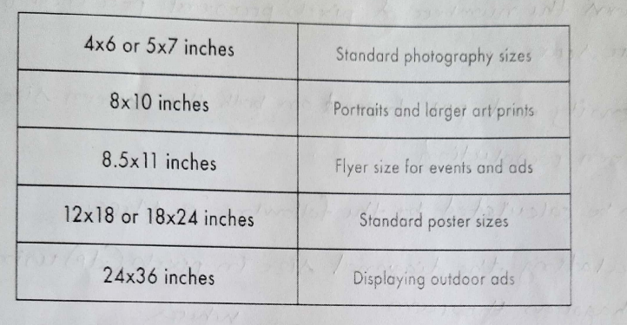

Slide 25
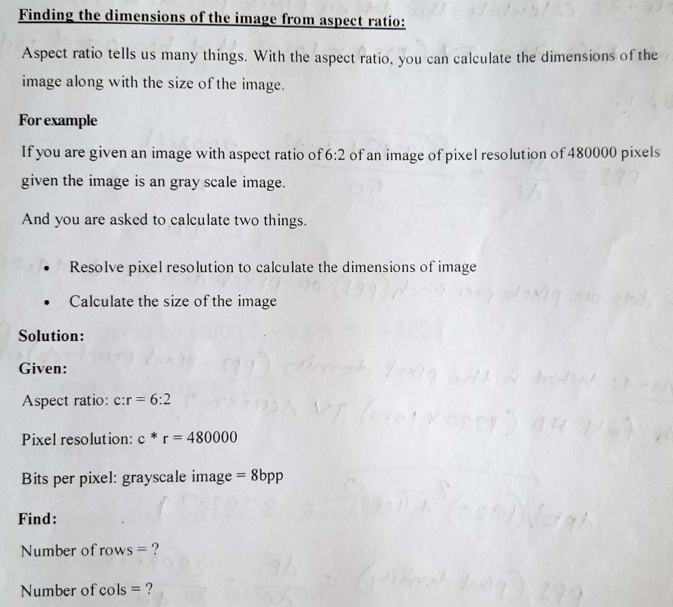

Slide 26
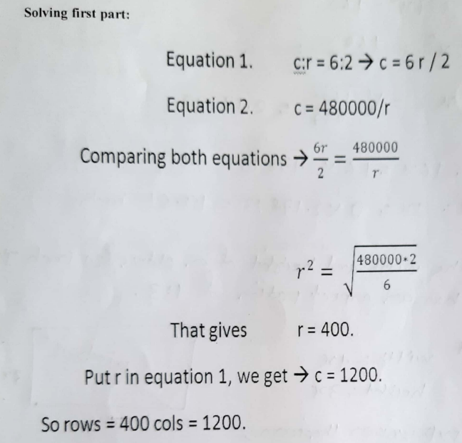
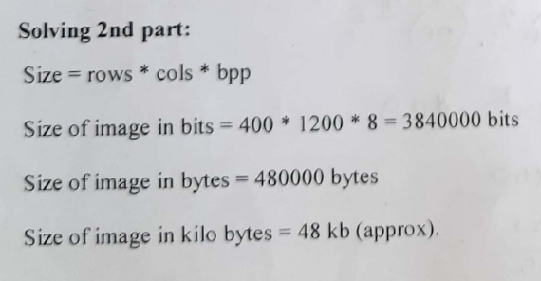

Slide 27
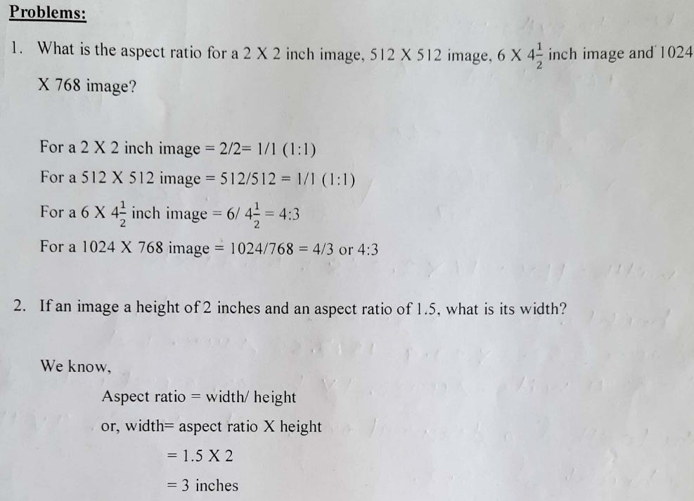
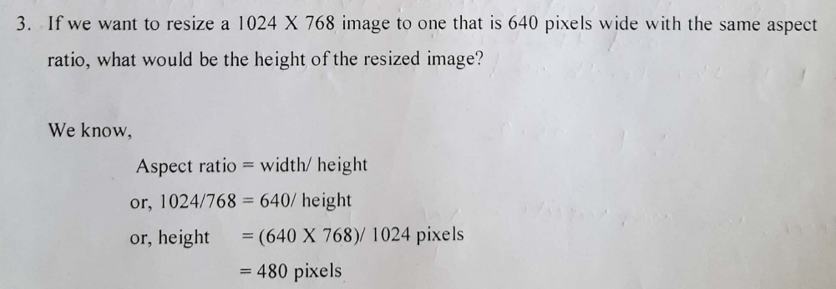

Slide 28
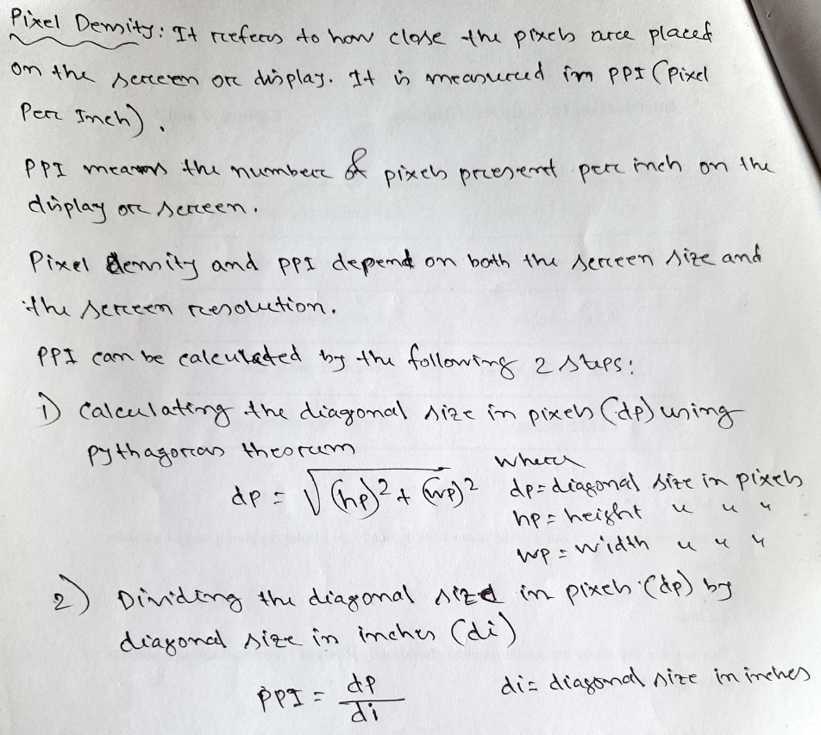

Slide 29
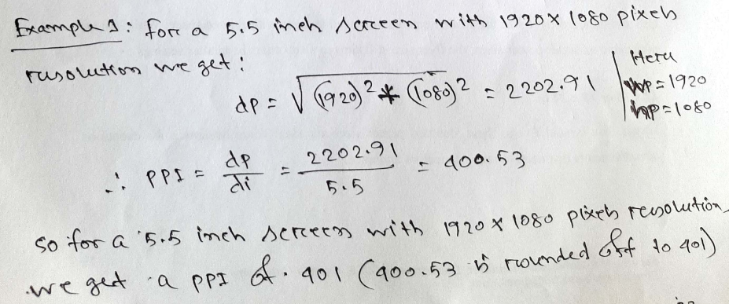
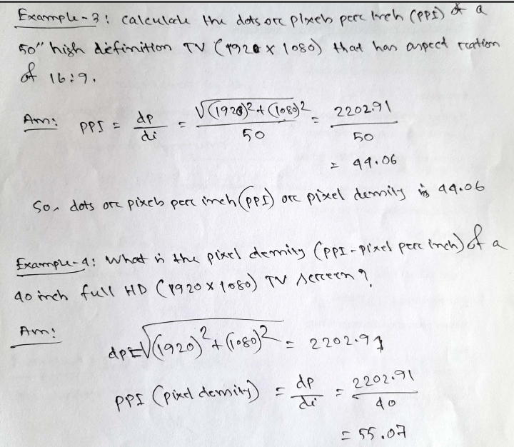
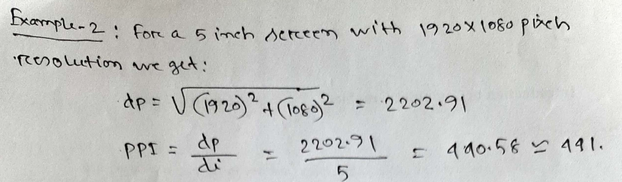

Slide 30
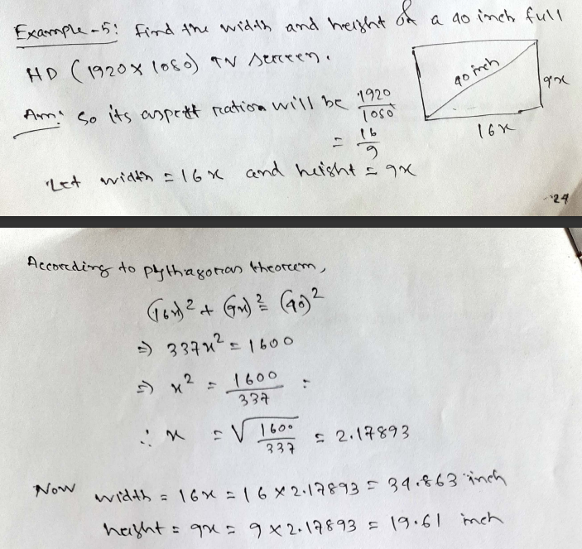
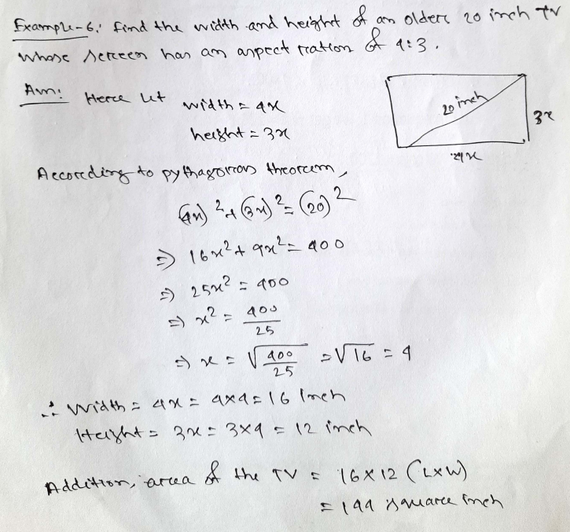

Slide 31
